Slide 1
DSS User Guide
M O L E C U L A R C O N N E C T I O N S (P) L T D. 2/2 Kandala Mansions, Kariappa Road, Basavanagudi, Bangalore - 560004,
Karnataka, INDIA. Tel: +91 80 4172 2217 Fax: +91 80 4120 8656 Web: http://www.molecularconnections.com/publishing/
Bangalore Chennai London New York Osaka Singapore

Slide 2
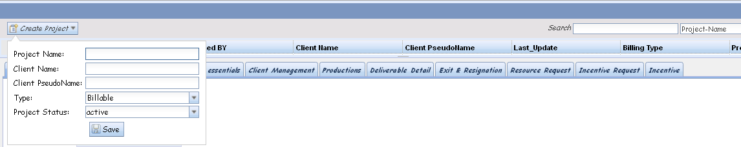
Creating a New Project
Create a
new project
One time filling needed
Create a New Project that you are managing- Project name needs to be unique and each project is assigned a unique ID
Billable/Non-Billable distinction can be used for client driven projects and inhouse projects respectively
Project status : Whether project is active or inactive requires to be added
Save the contents

Slide 3
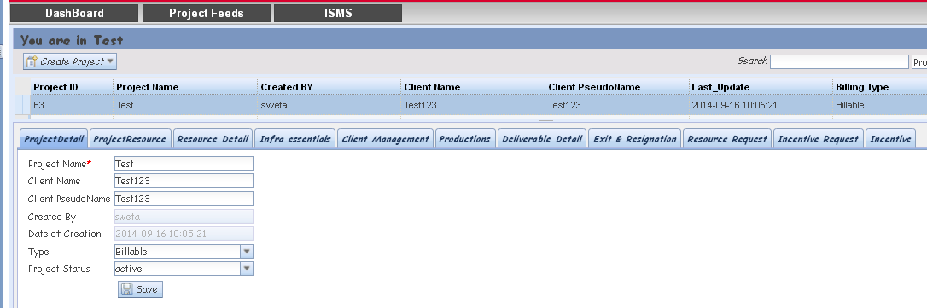
Creating a New Project
Double click on the created project
One time filling needed
Populates the lower panel “Project Detail” automatically
Once the lower panel gets populated with project details click SAVE.
Project status of a project could be changed here.

Slide 4
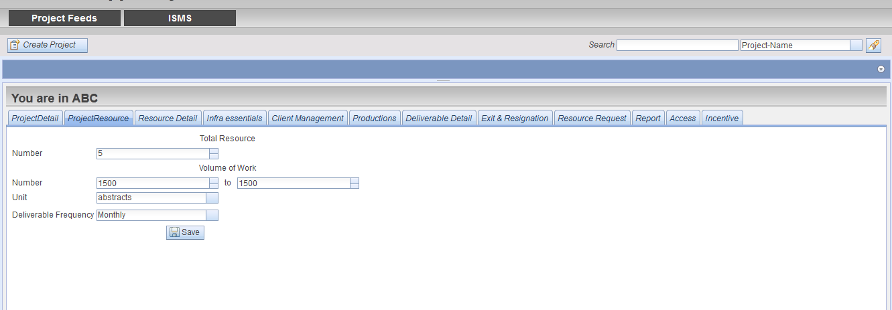
Creating a New Project
Click on “Project resource” Tab in lower panel
One time filling needed
Number- Enter Number of resources in the project
Volume of work – if a fixed number enter that or if it’s a varying volume enter both fields
Measurable Unit – volume measurement unit, is a controlled field
Deliverable Frequency- The content delivered to client weekly, daily, etc- controlled field

Slide 5
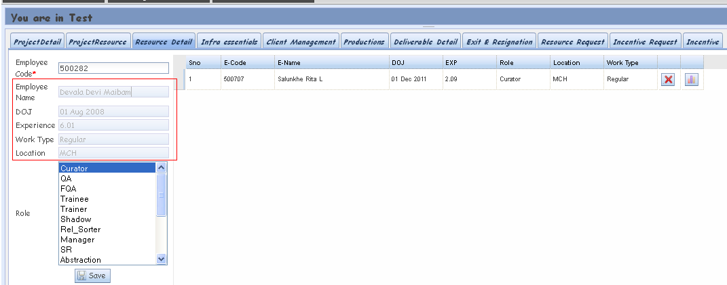
Adding Resource Details
Click on “Resource details” Tab in lower panel
Populates the lower panel with “Resource Detail” automatically from HRIS
Needs to be edited when new resources join or leave the project.
Employee code - Enter employee code for each employee in the project
Role – Enter the role of the employee in the project .Multiple roles can also be entered by selecting the roles using control.
After entering the employee detail click Save .
Data gets populated on the left panel.

Slide 6
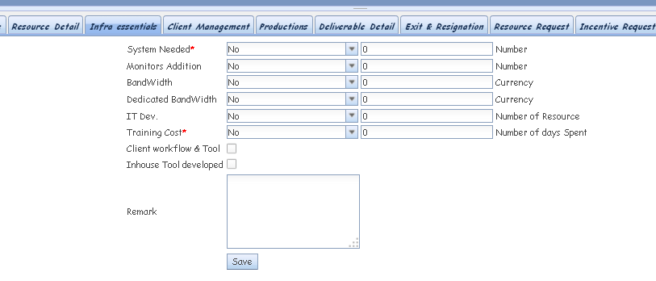
Infrastructural Details
Needs to be edited when new resources join or leave the project.
Enter all the project related infrastructural details and click Save
IT dev cost, Dedicated bandwidth cost would be filled by IT/Admin
Systems, Monitors, Training needs to be filled by PMs.

Slide 7
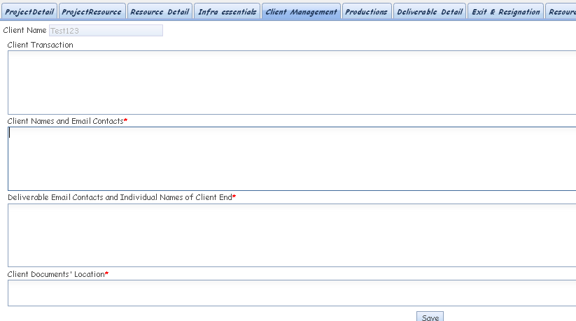
Client Details
Needs to be edited as and when needed
Panel to store critical client mail transactions which could be pasted here. All Client names and email contacts can be documented here.
Paste the URL of the Client Contact

Slide 8
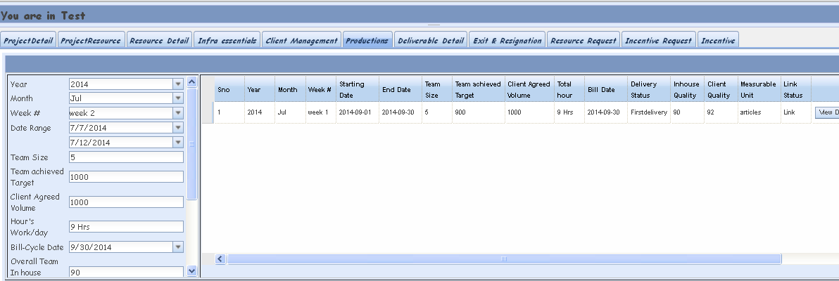
Production Details
Click on “Production” Tab in lower panel
Needs to be created every week
This report needs to be filled every week, irrespective of the project turnaround.
This panel acts as a concise production report panel for overall team measures

Slide 9
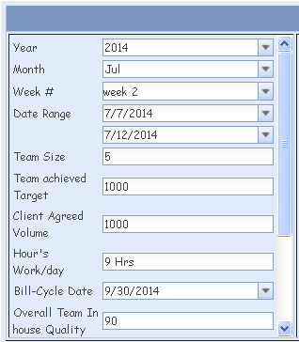
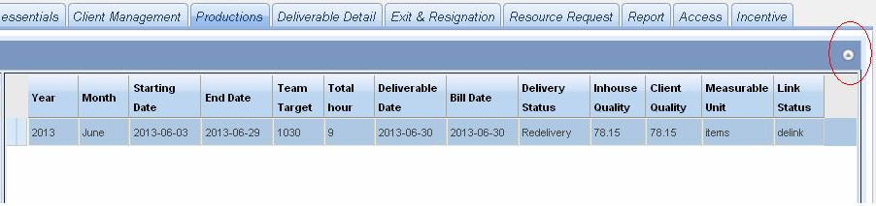
Concise team production report
Week number to be entered here (from 1-5)
Team target achieved for the week and expected client target as agreed to be entered here
Needs to be created every week
Click on the production detail tab in lower panel and then on this button to generate employee production form
Double click here to get the employee production entry panel

Slide 10
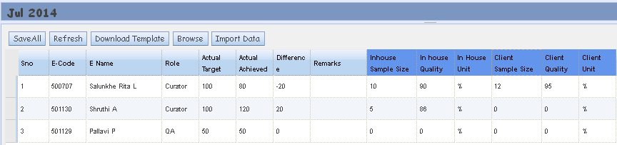
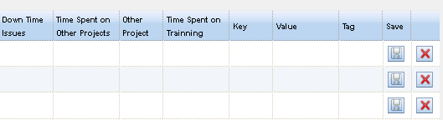
Employee Production Details
Needs to be created every week
Detailed individual production report “for the Week” for each employee
Other project name
Time spent on other projects is a means to account for resources working on multiple projects
Key –Value Field - Key specifies the field name & value specifies the actual value of that field.
Tag field – Use tag to enter any field that is not defined by the role field or anything else.

Slide 11
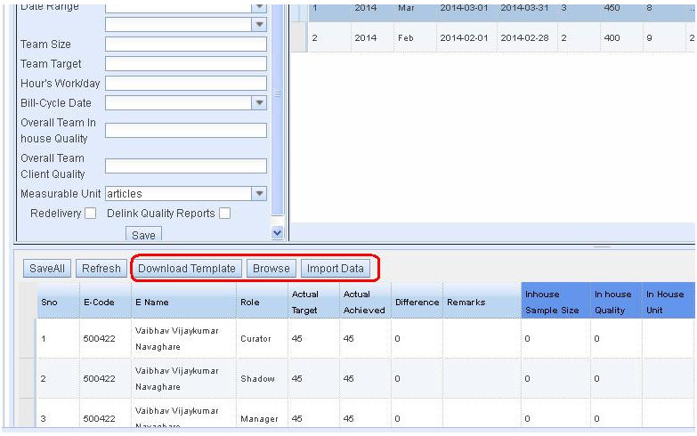
Excel Upload Feature
Fill in the data
Employee details (ie name , code and role ) will already be present in the excel. Users require to fill in the other data and save the excel .
Users should avoid entering the employee code themselves as it can lead to errors.
Download Excel
Go to Production detail tab .
Download the excel template using "Download template". (The template contains employee & role details from the Resource Details tab)
Upload the Excel
Click on "Browse" and select the file.
Using "Import " upload the file .
Review the data & Click Save All.
In case of any errors the program shows a dialog box listing all the errors.

Slide 12
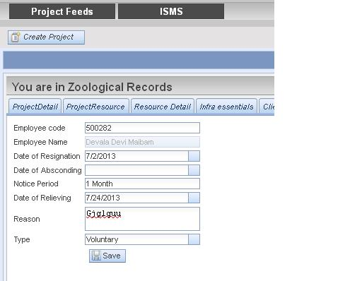

Exit and Resignations
Needs to be created when resources exit a team
Following resignations, absconding issues- this form needs to be filled for records.

Slide 13
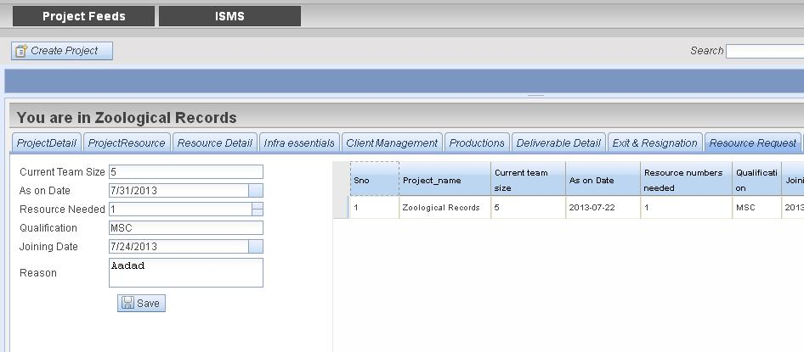
New Resource Request
Needs to be created when new resources are needed
New resources needed: nos, joining date preferred. HR signoff will be done post this form is filled.

Slide 14
Deliverable tab
Previously deliverables were entered once at the end of the month and the same data was used for the invoice. But now since weekly data and monthly invoice data has to be entered separately .
Deliverable tab now has 2 tabs .
Data tab - Data tab is to be used to add weekly deliverable details ie weekly numbers delivered to the client or weekly production numbers . This data is not used for invoice process.
Invoices tab – Invoice tab is to be used to add the billing data for the particular month for the invoicing process used by finance . This has to be entered at the end of every month . Notifications and alerts will be created only for the invoice data.

Slide 15
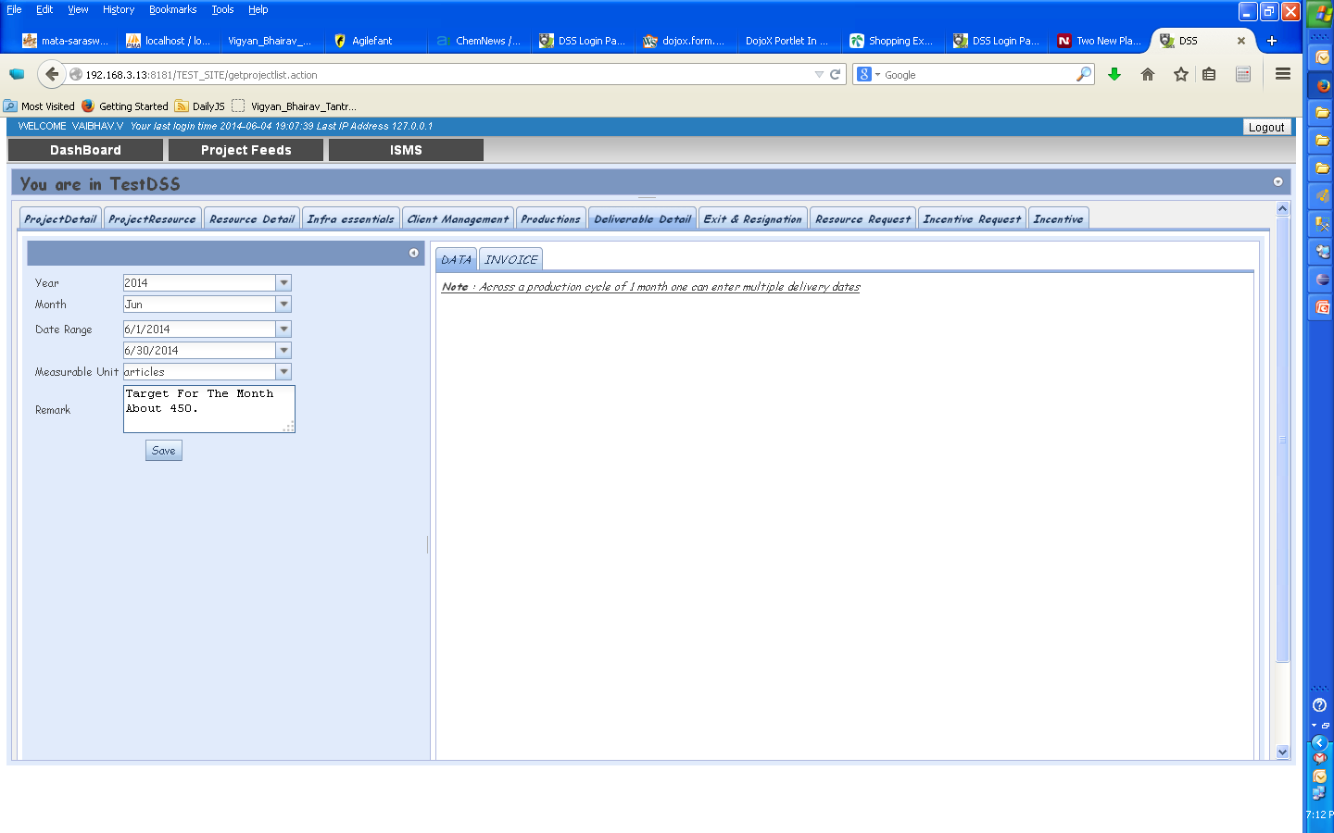
Creating a Deliverable Data Record
Deliverable record to be created once at the beginning of every month. On clicking “save” a record is created – under this record weekly data is entered every week for each month.
Enter data for a Month/Year & Click Save.

Slide 16
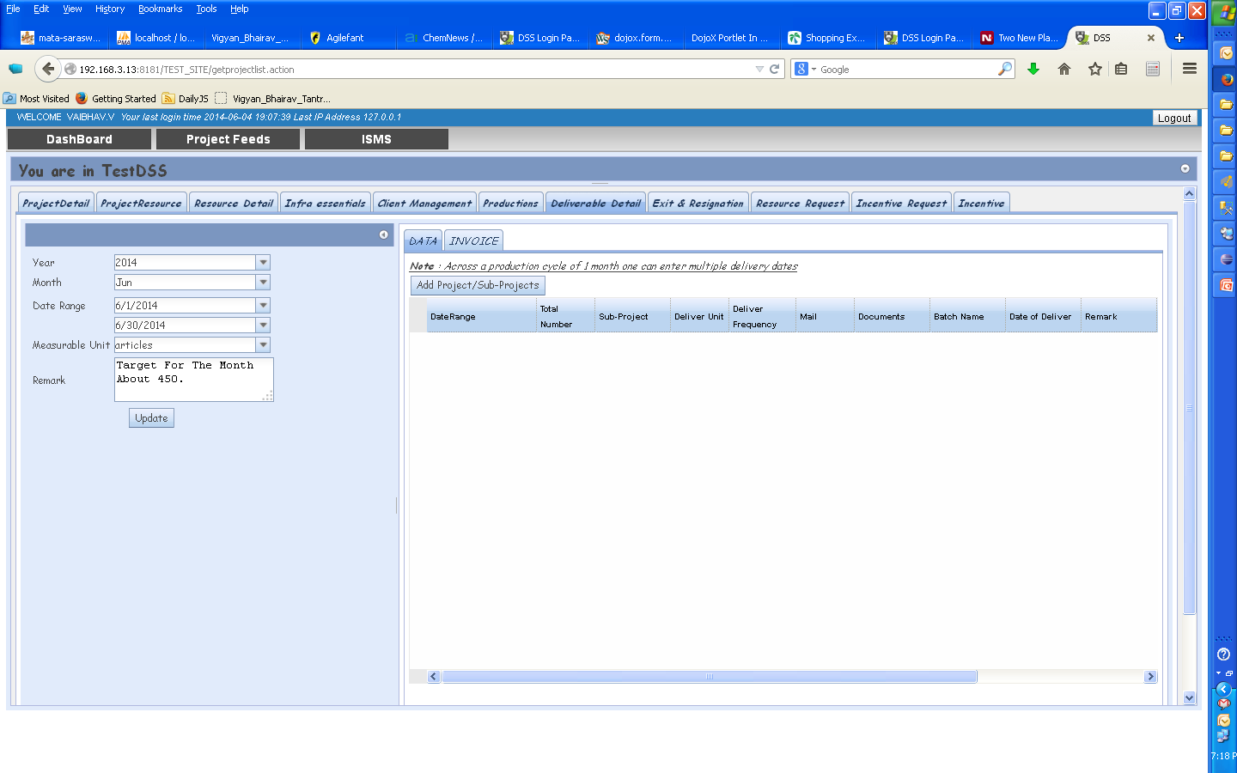
Once a delivery record is created select the appropriate tab to enter data.
DATA tab is used to fill weekly data.
INVOICE tab is used to fill in data at the time of invoicing only.

Slide 17
Data tab
Data tab is to be used to add weekly deliverable details ie weekly numbers delivered to the client or weekly production numbers .
User needs to enter data every week using this tab . (ie every Monday to enter data for previous week)
No Notifications are created here.
Deliverable Details Request will also not be created as before.
This data is not used for invoice process.

Slide 18
Creating a Deliverable Data Record
In DATA tab, Click on Add button to Add data

Slide 19
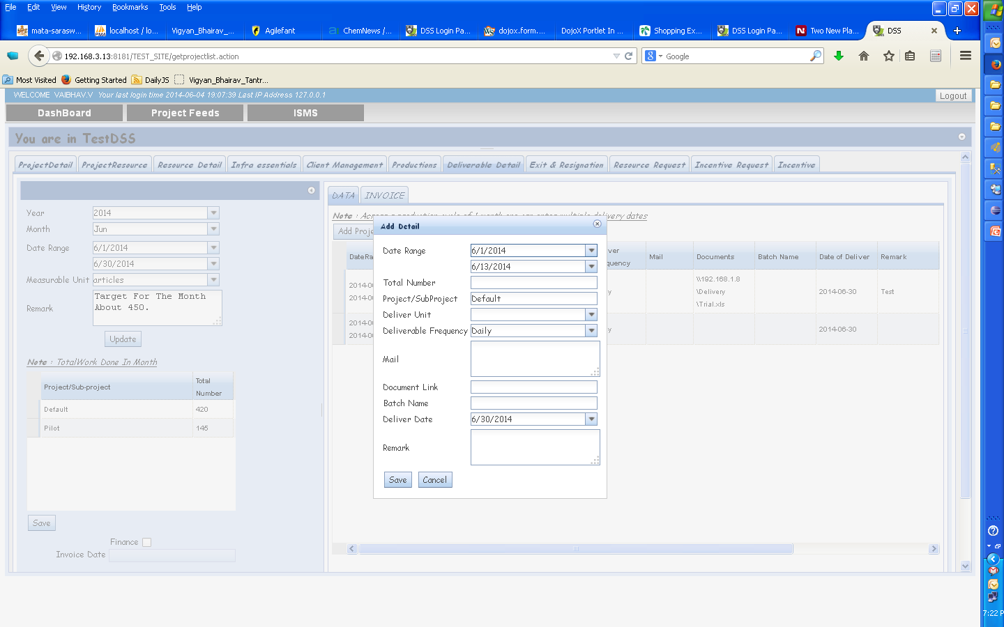
Creating a Deliverable Data Record
Weekly date range to be given in date range
Fill in data & Save it.

Slide 20
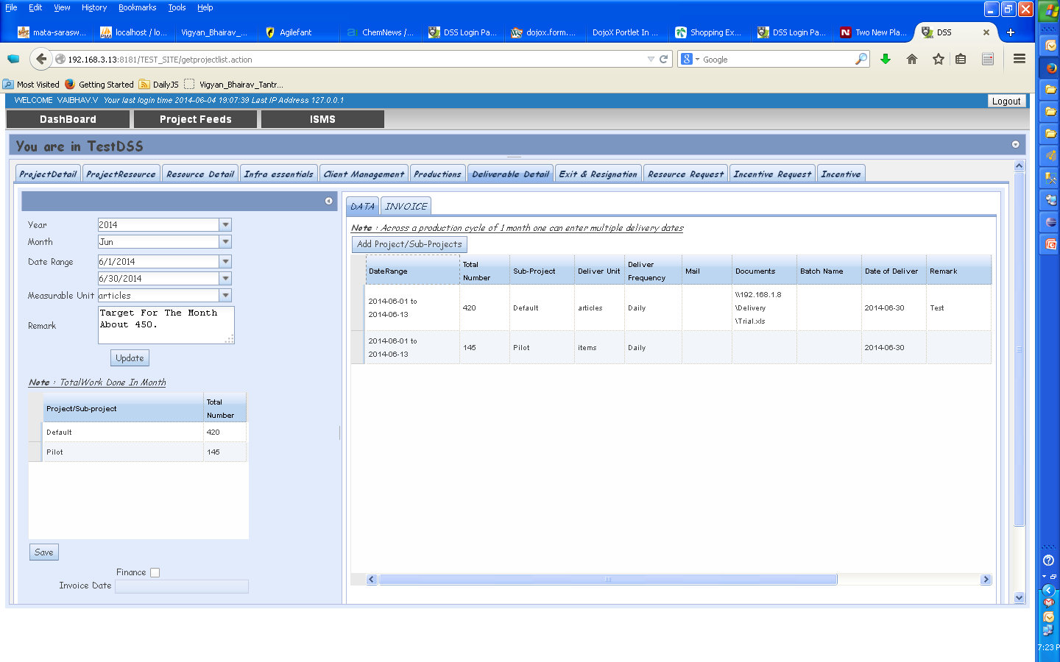
Creating a Deliverable Data Record
The panel on the left calculates the totals automatically.
Enter data for a Month/Year & Click Save.

Slide 21
INVOICE tab
Invoice tab is to be used to add the billing data of the project for the particular month for the invoicing process used by finance .
User enters data once a month for Invoicing.
Step 1
User creates an Excel file in a format expected by Finance & stores it in \\fileserver\Delivery<<Project>> folder.
This location is entered in the Invoice tab.
Step 2
Select invoice tab and enter the required details .
Step 3
Click on “Generate Invoice” to create Invoice request & send a notification to Finance.

Slide 22
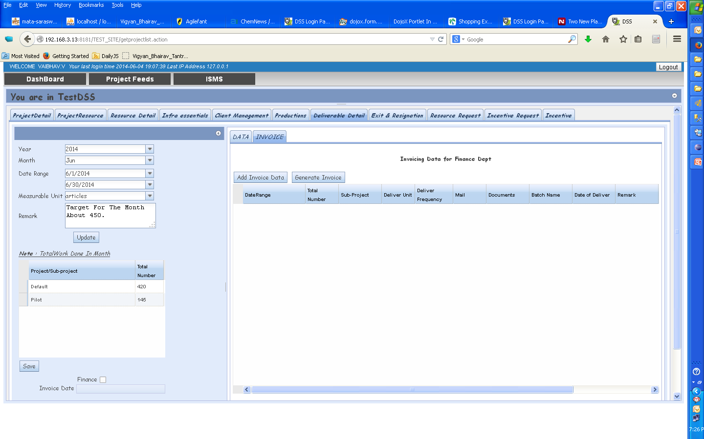
Creating an Invoice Record
Click on Add button to add data

Slide 23
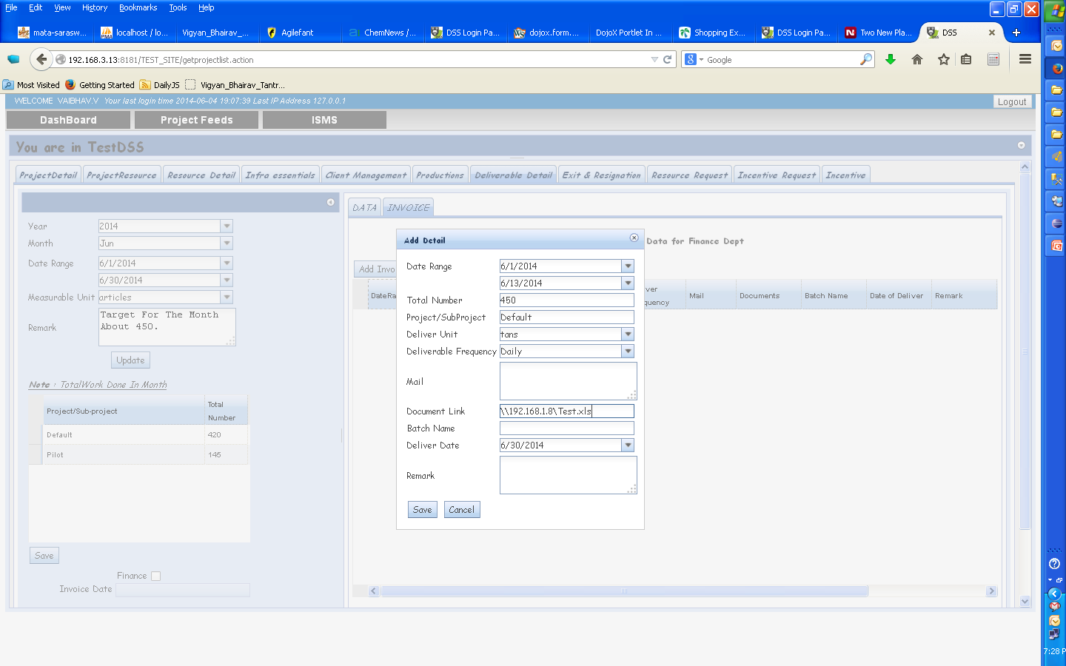
Creating an Invoice Record
User needs to enter the location of Excel file needed by Finance.
Fill in data & save it.

Slide 24
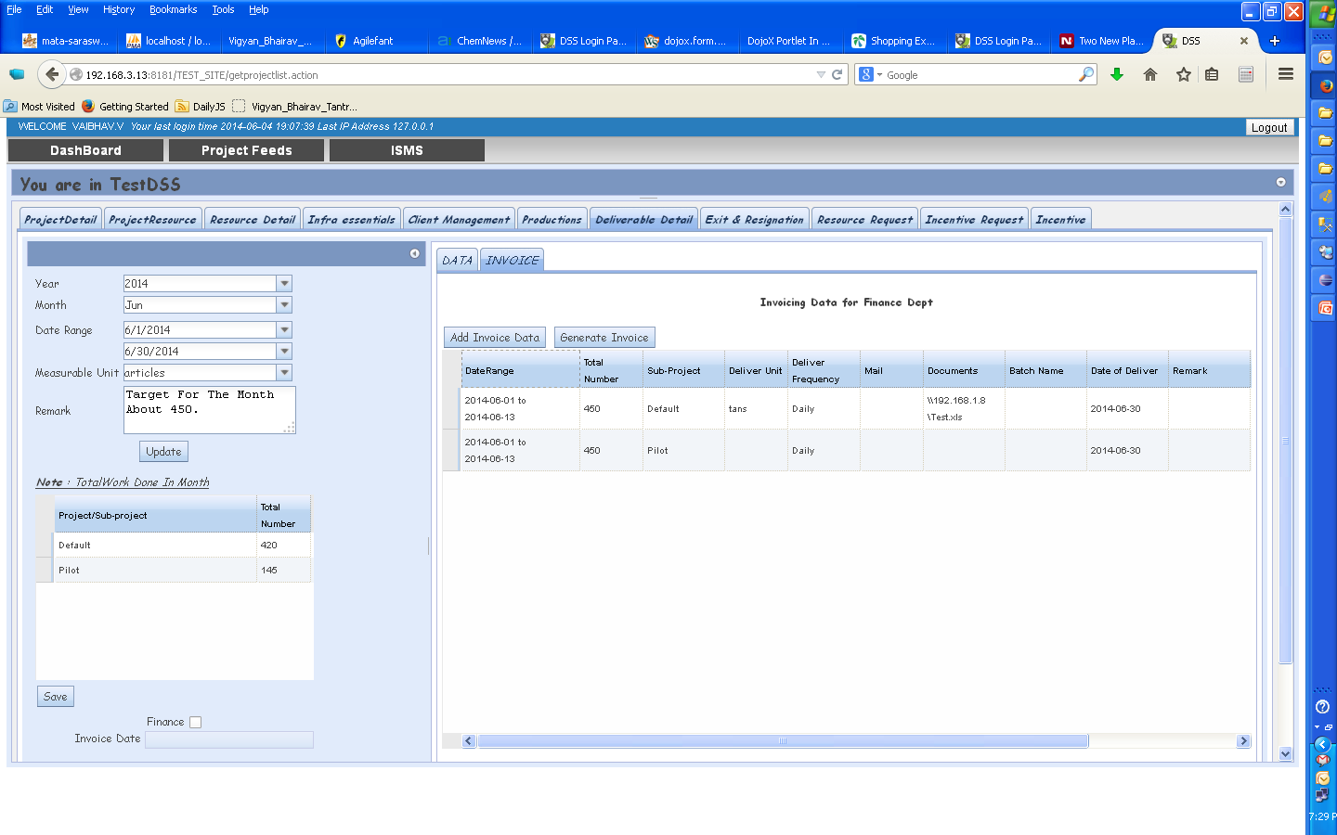
Creating an Invoice Record
Click Generate Invoice to generate the Invoice.
A notification is sent to the Finance.

Slide 25
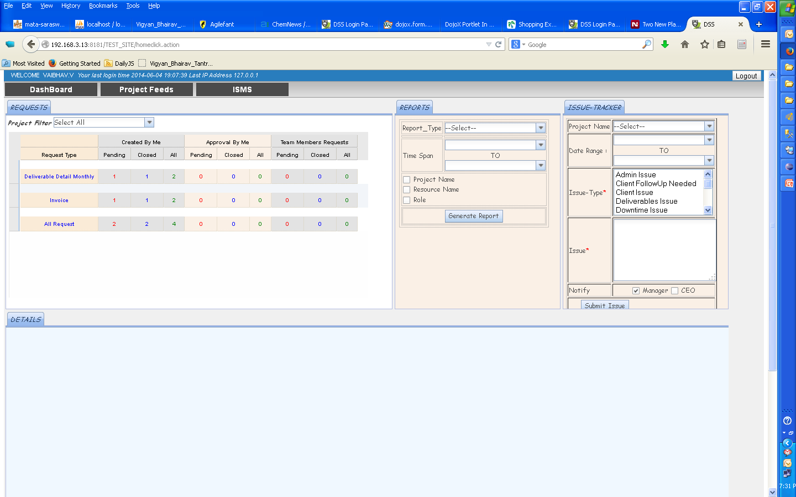
Creating an Invoice Record
Invoice Request is created in the Dashboard

Slide 26
Approving an Invoice Record
Finance opens the Invoice Request -> Looks at the data in the Excel file -> Approves the Invoice (if everything is OK)
Finance may ask the user to edit the Invoice in case of mistakes.
In case of mistakes, the user has to edit the Invoice & “Generate Invoice” again. Finance can then approve the updated Invoice.
Once approved a notification is sent and same appears on the dashboard

Slide 27
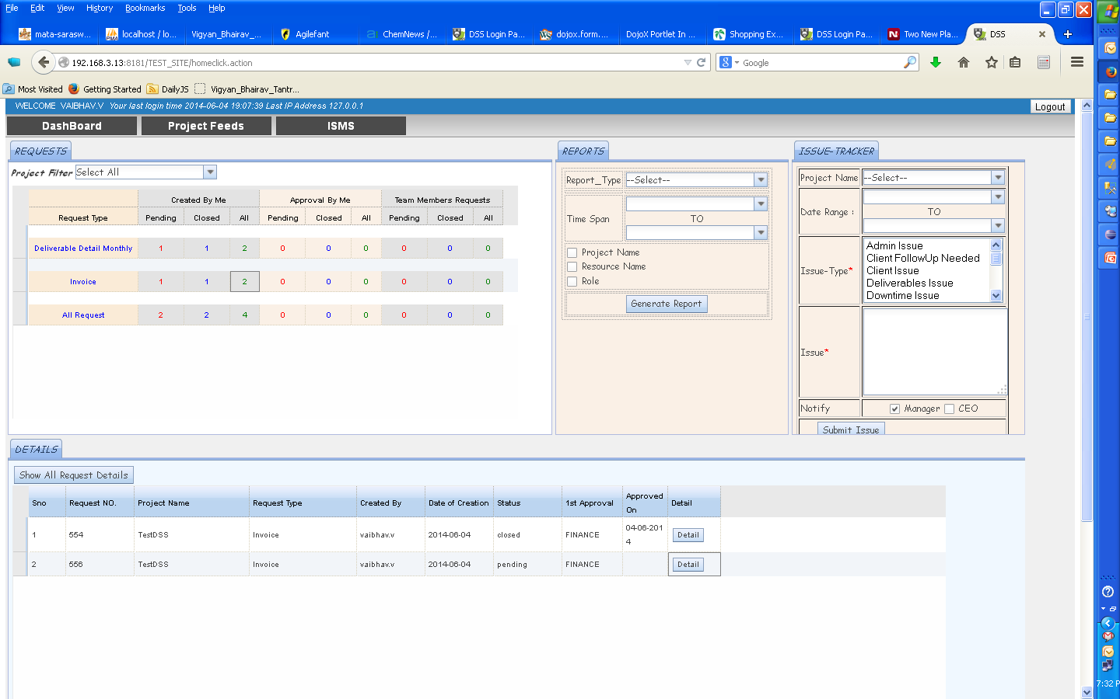
Approving an Invoice Record
Invoice Request is created in the Dashboard.
Click Details to see the details.

Slide 28
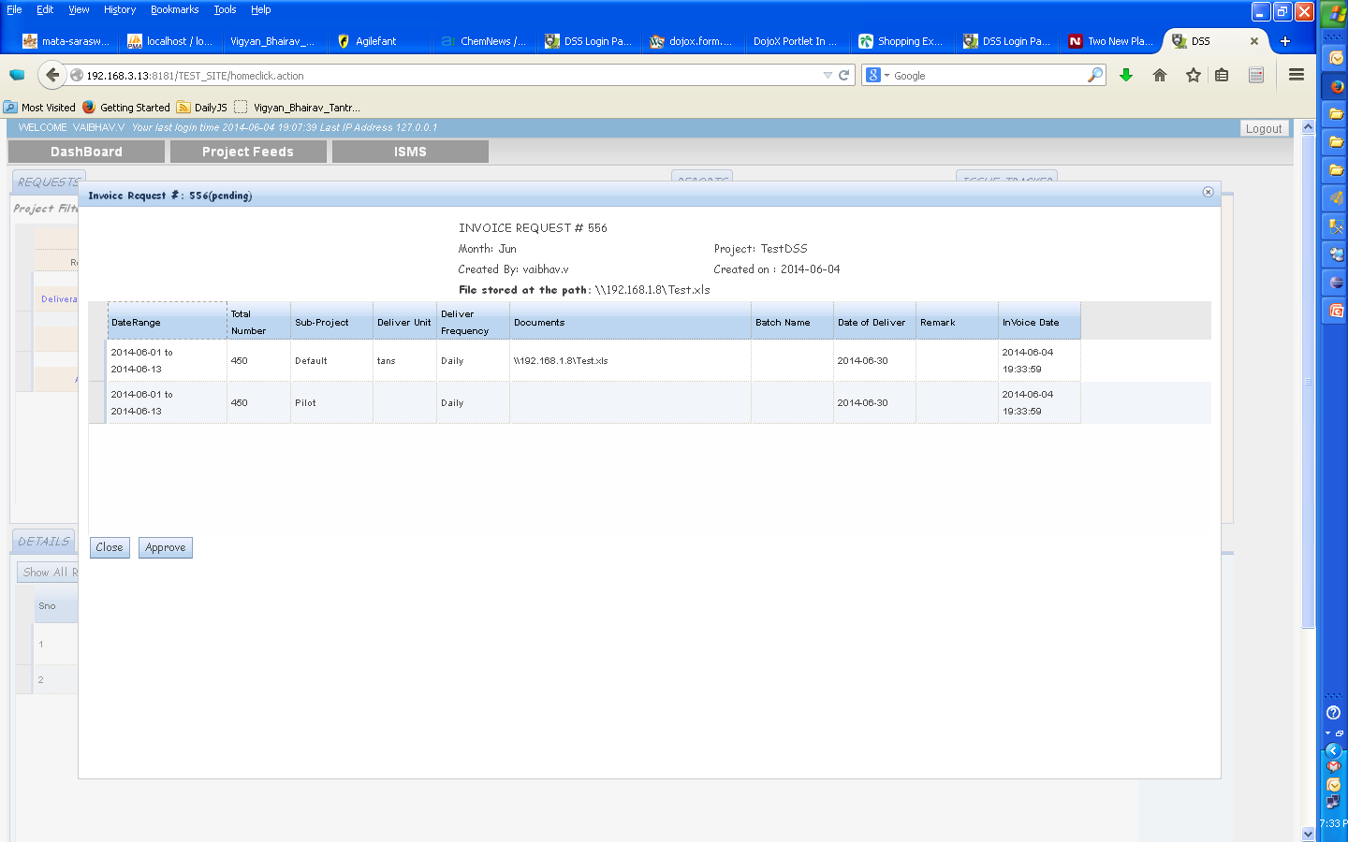
Approving an Invoice Record
FINANCE can view details in a project specific format in a file stored at the location shown.
Each user needs to store this file on the file server & input the location in the Invoice Tab

Slide 29
Approving an Invoice Record
FINANCE can approve the invoice using Approve button

Slide 30
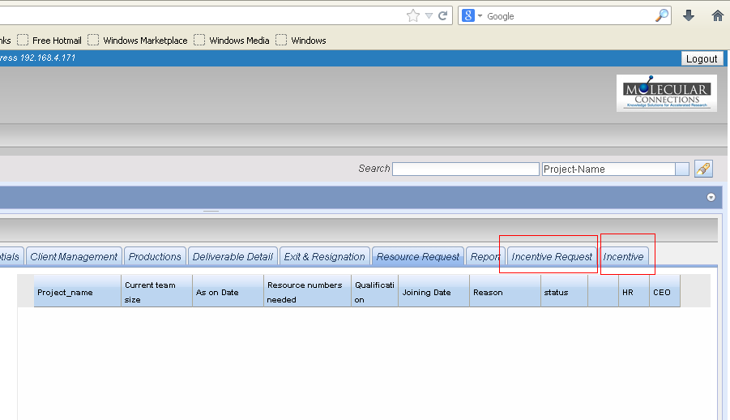
Incentive Tabs
There are 2 tabs for Incentives.
Incentive Request Tab - Request form for a new incentive plan.
Incentive Tab - Regular incentive details for each month to be filled in here.

Slide 31
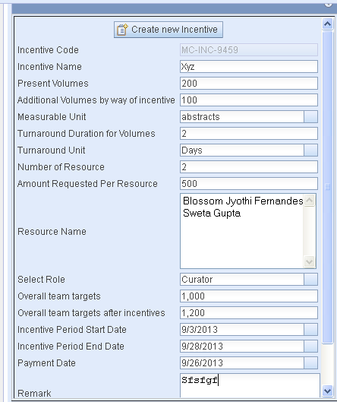
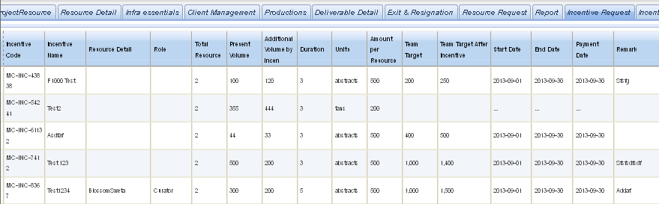
Incentive Request Tab
All new incentive plans to be created by using the Incentive Request Tab. This form is required to be filled once.
Steps
1 . Click on “Create new Incentive”. It brings a new form. Each incentive approved is given an unique ID which is randomly generated.
2. Fill in all required information into the form (Details of field – incentive reference document) and Click “SAVE”.
3. Data is saved on the right hand side of the Panel as shown here.

Slide 32
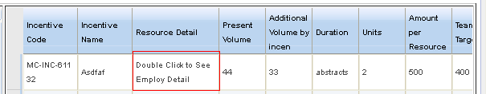
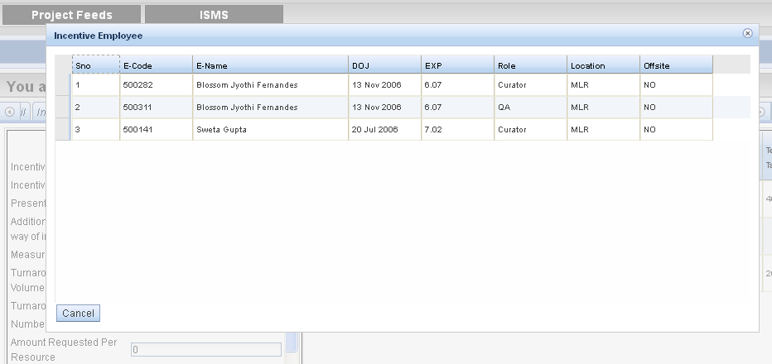
4. Checking for employee details
Employee details like role etc can be checked by double clicking on the resource detail.
5. Alert mail goes to CEO for Approval
6. Once Approved the regular incentive details for each month can be filled using “Incentive tab”

Slide 33
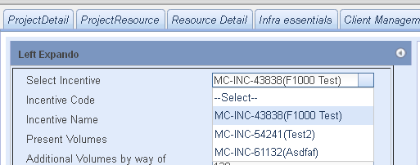
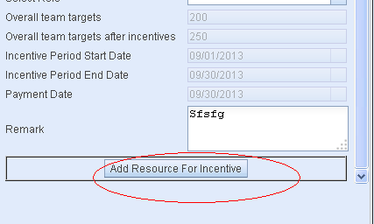
Incentive Tab
Once approved the incentive plan can be chosen in this panel and regular details like volumes , incentive amount for each month for each employee can be entered here.
Note : Only Volumes, Resources , and incentive amount fields are editable. Rest of the details will be automatedly filled as entered in the Incentive Request Tab.
Steps
1.Select the incentive plan from the dropdown.
2. Same incentive request form is displayed here .
3.All details entered in the incentive request form are automatedly filled in .
4.Click on “Add Resource For Incentive“

Slide 34
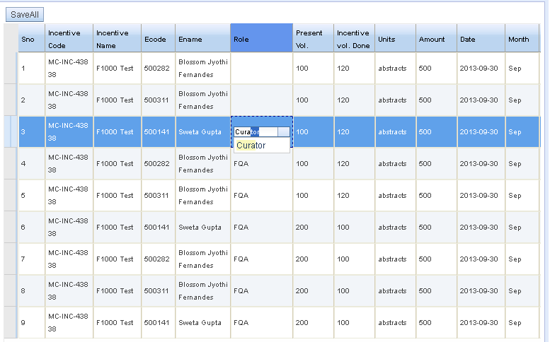
5. All details are saved and appear in the right hand side of the panel.
6. Present volumes , Additional volumes by way of incentive , amount requested, resource name , role and remarks are editable and can be edited for individual employees. Targets can be be altered and entered as per Role.
7. To Enter a new Role / Resource .
New resource or new roles can be added which were not mentioned in the incentive request form can again be added separately using the form on the left panel in the similar way.

Slide 35
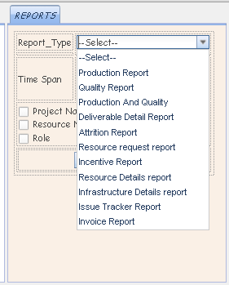
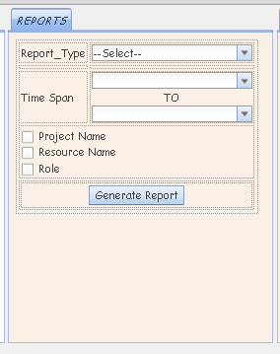
Reports
Select the type of report to be generated
Reports can be refined based on 3 filters as well as time span

Slide 36
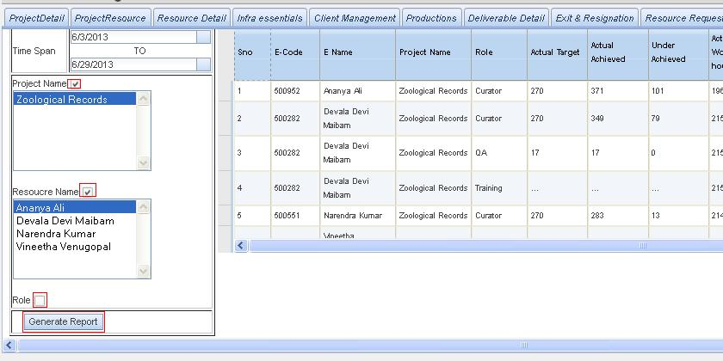
Production Reports
Generating a Report

Slide 37
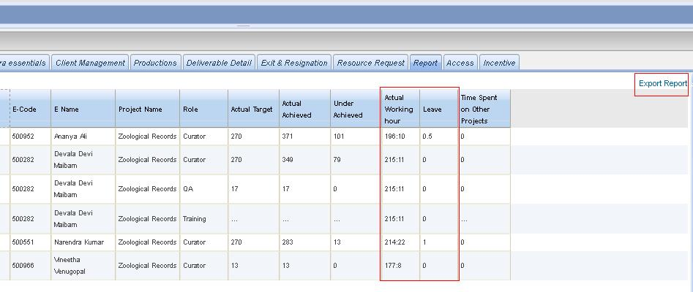
Production Report
Populates working hrs and leave details automatically from HRIS

Slide 38
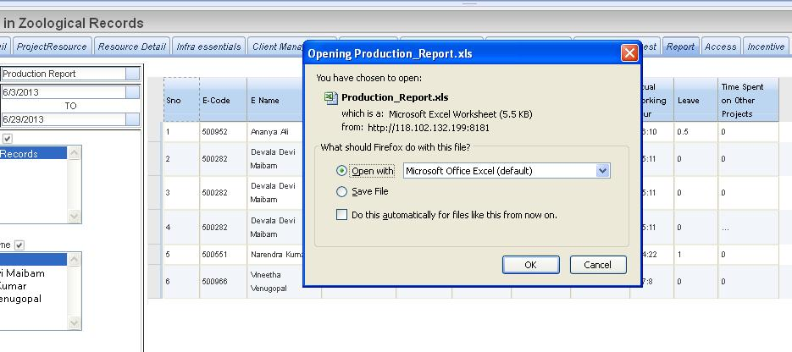
Export of Reports

Slide 39
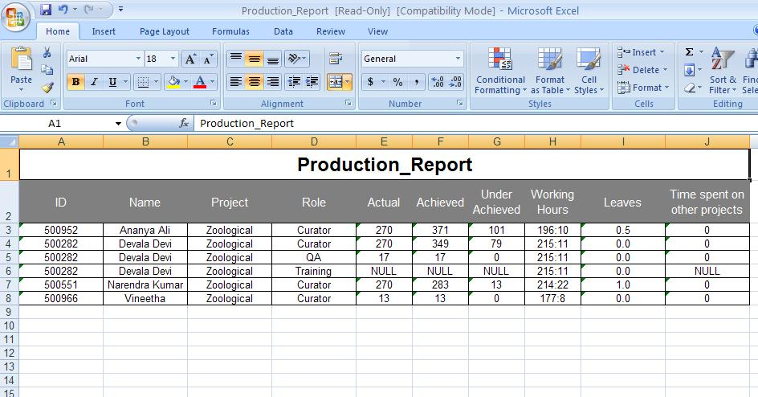
Export of Reports

Slide 40
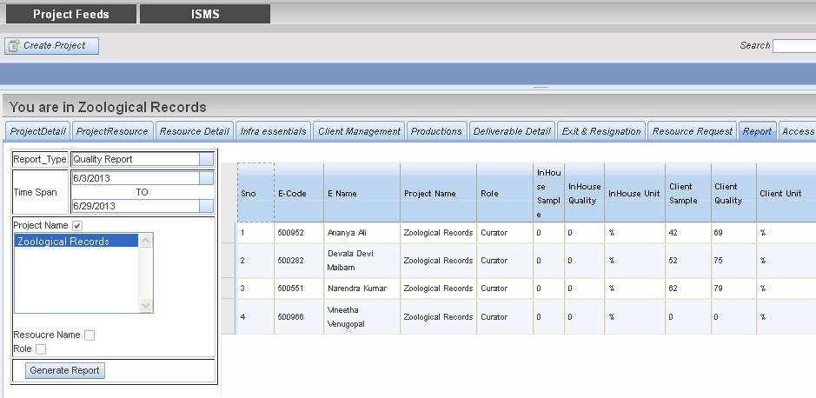
Quality Report
Generating a Report

Slide 41
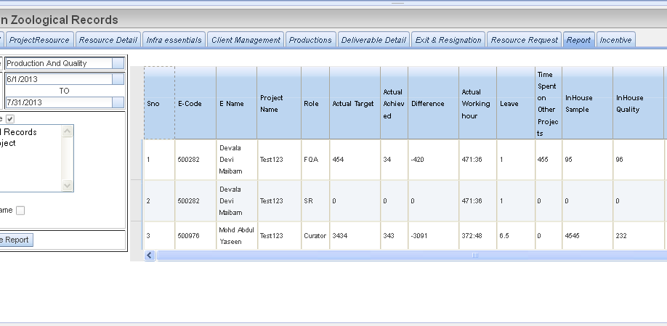
Production and Quality Report

Slide 42
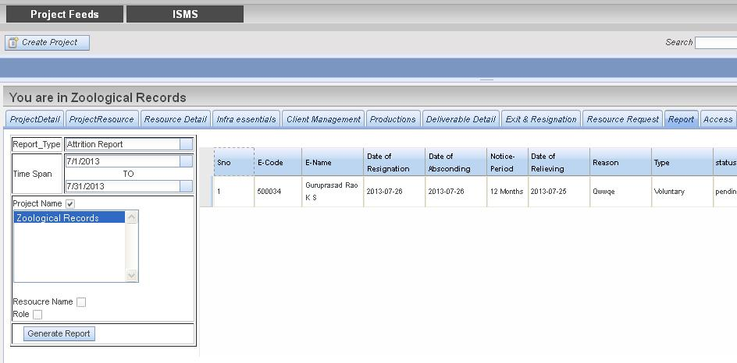
Attrition Report
Generating a Report

Slide 43
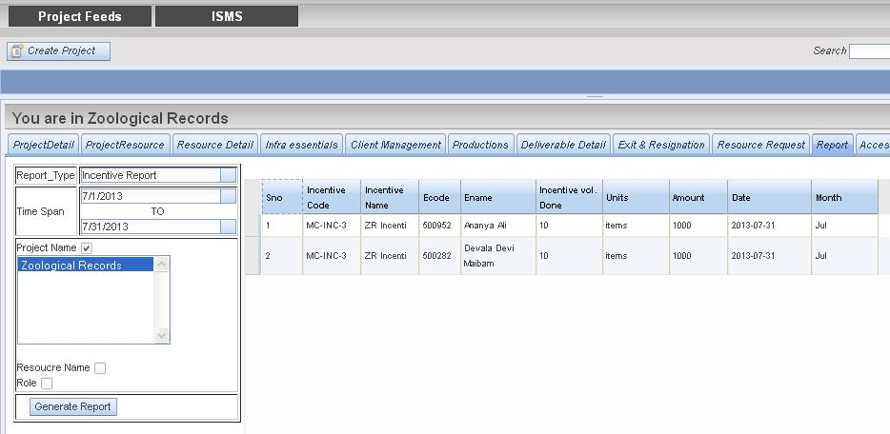
Incentive Reports
Generating a Report

Slide 44
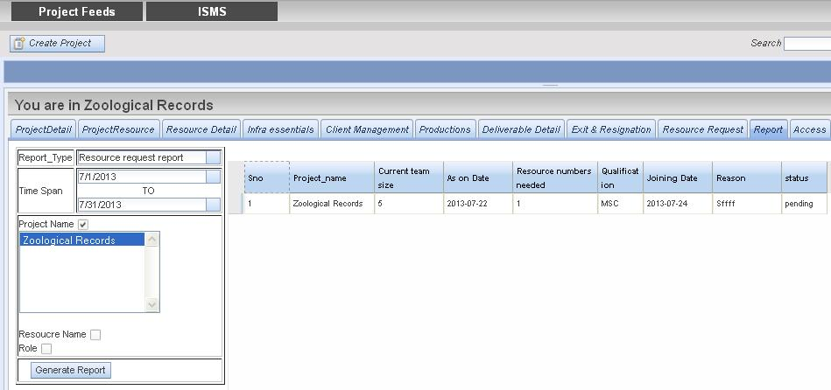
New Resource Request Report
Generating a Report

Slide 45
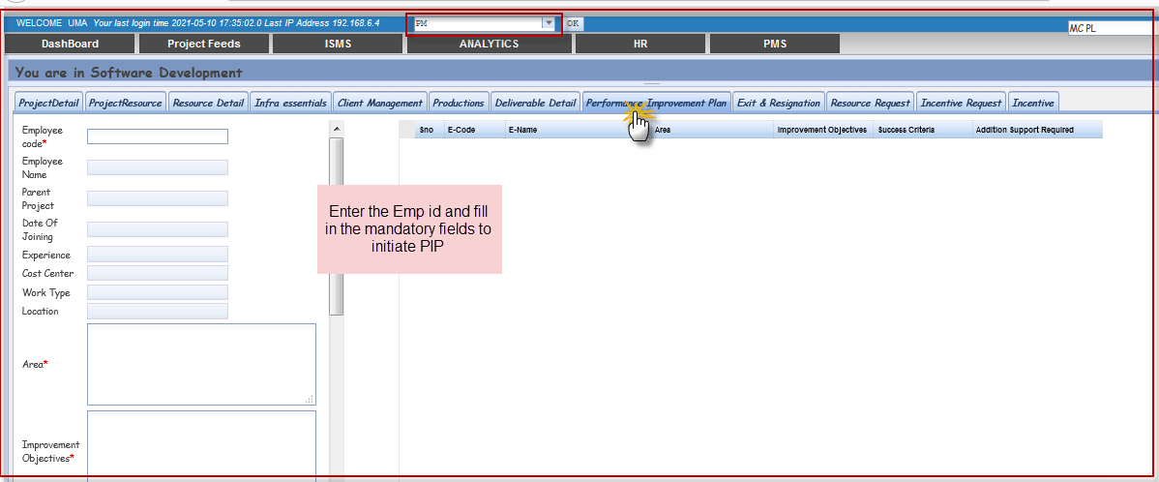
Performance improvement Plan(PIP)

Slide 46
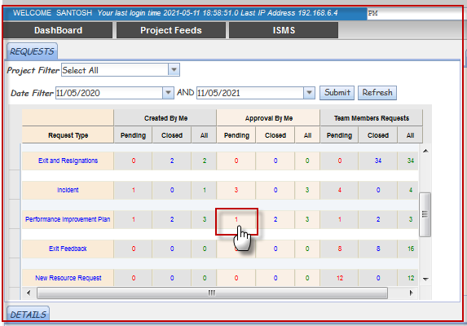
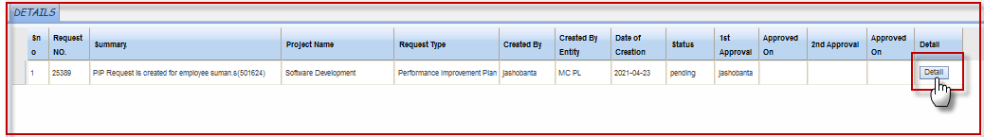
PIP (Review and Update)

Slide 47
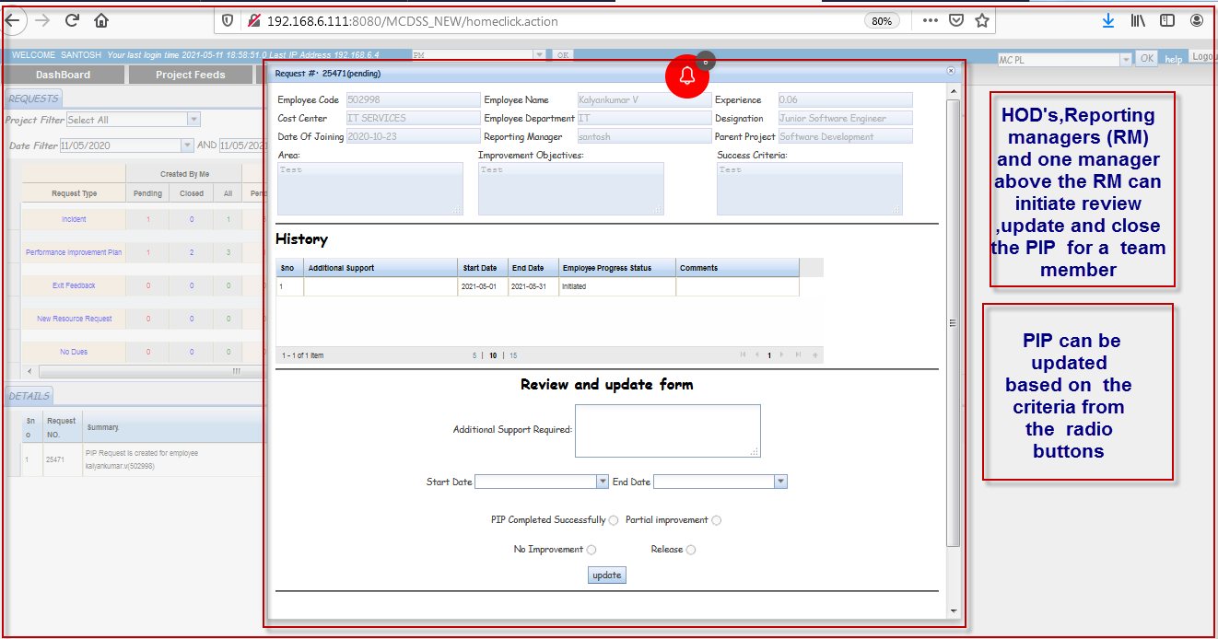
PIP update and closure

Slide 48
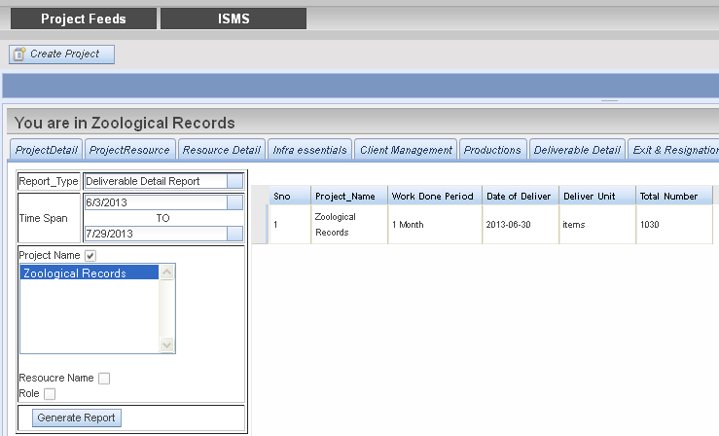
Deliverable Report
Generating a Report

Slide 49
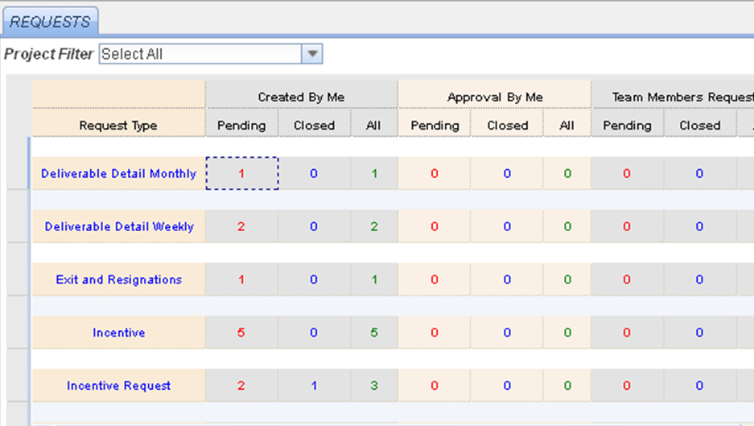
DSS Dashboard
DSS Dashboard is a Display to help tracking of the different requests and approvals made by a User. All the requests created by a user or requires approval are documented and displayed on the DSS Dashboard . These would also be accompanied by email notifications. ( documented in excel - DSS alerts )

Slide 50
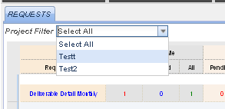

Select a project using Project filter
All Requests are displayed below (as shown below )
The Requests are classified into 2 categories -
Request Type - Based on the kind of request - the requests are classified into categories like Deliverable detail, Exit and resignations etc .
User Type – Based on the User Purpose of the request they are classified into 3 categories –

Slide 51
Created by me - If a request is created by a user it would be shown under “Created by Me”.
Approved by me – If a request is created by someone else but requires the user’s approval it would be shown under “Approval by Me”.
Team member requests – There may be many requests where the user is keep in the loop. Such requests would be shown under “ Team Member Requests”.
User can also view the requests based on its processing status – “Pending , Closed and All” (in case one wants to view all together).

Slide 52

Viewing the Request
To view the details of the request “click on the number” shown .
below.
The details are shown in the Details panel

Slide 53


Clicking on the “Detail button” it takes the user to the Main Page of the Request .

Slide 54

Clicking on details button would display requests one at a time for each request. In case if the user wants to see all requests together user could click on “Show ALL Request Details “. This would display all requests together .
In case if the user is an Approver he could approve all the requests on this page

Slide 55

Issue Tracker user guide
The issue tracker will enable PMs to record information on any issue/difficulty pertaining to the project production on a day to day front. Examples -volumes going down, or more complex reactions coming up and reduced productivity etc .
An issue is entered by the manager along with date and project name
Once an issue is entered manager can select option of Manager or CEO or both using “notify option”
Depending the option selected an email alert goes to the reporting manager or the CEO desk or both.
A PM can enter the issue tracker daily, or can add multiple notes for a day too.

Slide 56



Issues Tracking
The issues can be tracked in the form of a report present in the Report Panel .

Slide 57
NO Due form- DSS Protocol
Alert sent to IT, Finance and Admin and request appears on dashboard
Alert sent to HR request appears on dashboard
IT Fills the details
Creation of No due Form by HR
Manager Fills the details
Closed by HR
Finance fills the details
Alert sent to Manager and request appears on Dashboard
Admin fills the details
Alert sent to all

Slide 58


Note : ISMS tab to be used only by HR for creating No due request and marking in Relieving Calendar.
HR creates the no due request by using ISMS tab . Enter ISMS tab and click on No due request .

Slide 59


Slide 60
Alert sent to Reporting Manager and request appears on the Dashboard
Click on detail in the lower details panel to open the no due form

Slide 61

Report Manager completes filling the No due form and clicks on submit
Alert is sent to Admin, IT, Finance and HR and the same appears on the Dashboard

Slide 62


Slide 63

Once Admin /IT /Finance complete filling in the details and submits the form an alert is sent to HR for Closure.

Slide 64

HR
HR closes the process by completing the form.
Alert is sent to all and same appears on the dashboard

Slide 65
Thank you
For any suggestions/bugs or assistance,
Email: guru@molecularconnections.com

